Slide 1
Emergence of Bangladesh (EMB101): Lesson 4
British India 1747-1857

Slide 2
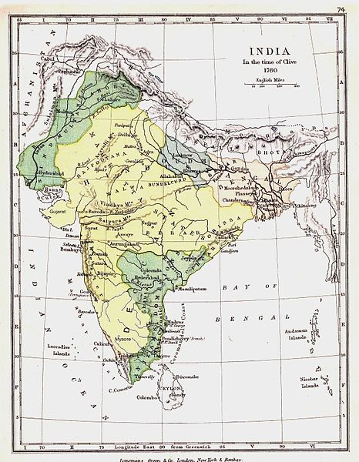
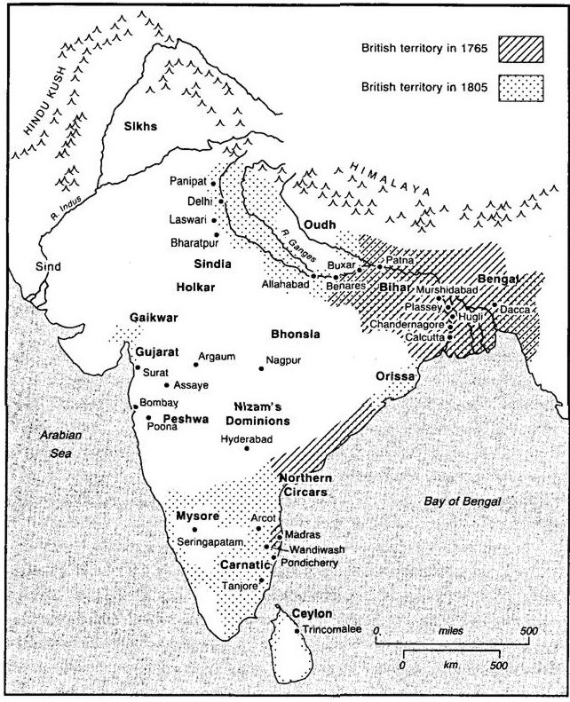
Growing British Empire in India

Slide 3
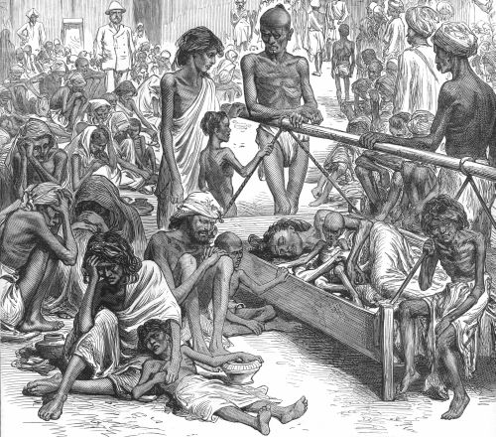
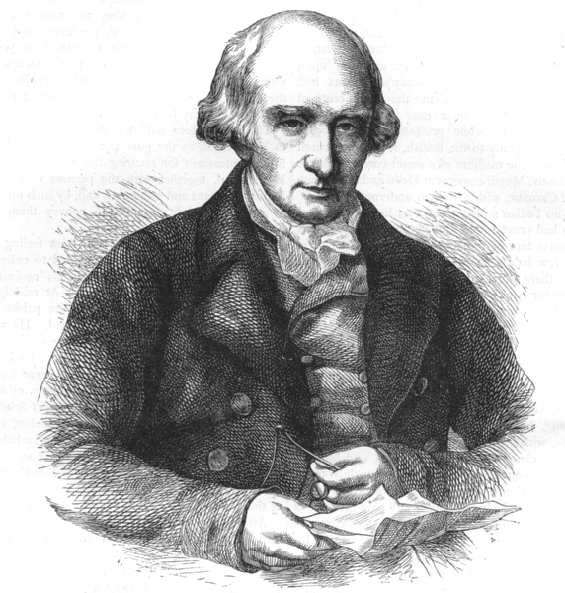
British East India Company continues to experiment with ruling system till 1772
Land tax was increased fivefold
Shortfall in crops in 1769
These resulted a severe famine in 1770
To overhaul the management of the East India Company's rule in India the Parliament of Great Britain passes The Regulating Act of 1773
This law created a new post Governor General
Warren Hastings was the first Governor General

Slide 4
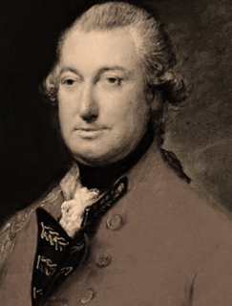
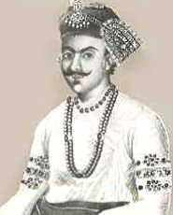
The Permanent Settlement of 1793
Sunset Law
Zamindar Class

Slide 5
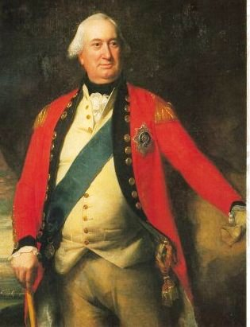
Permanent Settlement Act, 1793
The British (having property rights to all land in Bengal) changed the role of the zamindars, who were hereditary revenue farmers before. Zamindars now became de facto landowners (acting as a landlord/manager, not an actual owner) and the peasants became their tenants.
The British fixed the tax demand in perpetuity rather than for a temporary period of 1, 5, or 10 years. In return, they had to pay a fixed amount of tax (a part of it as revenue collected from their tenants) before the end of the Bengali year. Failure to pay the tax would result in their land being auctioned off and property rights sold to others.
Lord Cornwallis

Slide 6
Objectives of Permanent Settlement Act
Providing opportunity for collecting higher taxes
Agricultural development (surplus revenue to be used in land development, buying better seeds and instruments, irrigation, and transform marchland/swamps into cultivable lands, etc.)
Creating a loyal elite class (Social hierarchy)

Slide 7
Impact of the Permanent Settlement Act
Many zamindars lost their land, unable to pay huge taxes
Farmers suffered due to over taxation and other forms of oppression
New landlords started growing from intermediaries and business elites (i.e., Rise of sub-infeudation)
Impoverishment of the peasantry

Slide 8
Impact of the Permanent Settlement Act
Taxes were doubled. Zamindars often failed to pay high taxes and lost their land.
Increase in the number of the Zamindars in Bengal
1772 | 1872
Slightly more than 100 | 1,54,200
Source: Umar, Badruddin (2008). Chirasthayi Bandabaste Bangladesher Krishak (Peasants of Bengal in Permanent Settlement). Dhaka: Mowla Brothers. p. 21

Slide 9
Gold & silver bullion used to be sent to independent Bengal to buy products/goods; now bullion is leaving the country
Tax revenue is extracted from farmers. Products are bought from farmers & weavers using the same revenue!
The extraction of resources and revenue from the Indian subcontinent allows Britain to finance the Industrial Revolution
Creates a displaced peasantry who are then forced to join British mercenary army

Slide 10
Impact of the Permanent Settlement Act
Cash cropping for global markets (indigo, opium, tobacco, etc.: To sell for profit)
Linkages to the global economy
Bengal exposed to the instability of the global markets
Regional specialization
The rise of Calcutta and the decay of Dhaka

Slide 11
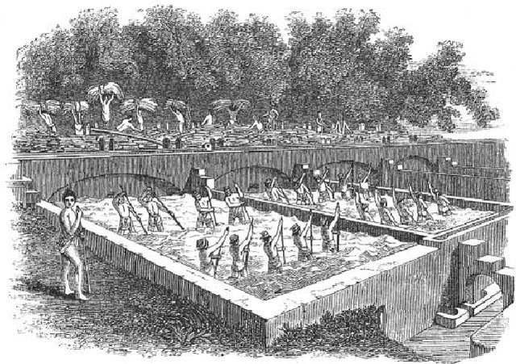
Impact of the Permanent Settlement Act
An indigo factory in 1850s

Slide 12
Impact of British Rule
Permanent Settlement Act changed the socio-economic structure of Bengal
British rule influenced the education and culture
Led social changes and reforms
Developed modern transport and communication

Slide 13
Nature of Colonial Policy
Some reforms helped Indian Society to grow positively and some had negative impacts
Core objectives of most reforms were to serve British administration
British claimed reforms were to civilize the Indians
This was truly reflected in the following statement of Thomas B. Macaulay (the law member of the Bentinck’s council):
The aim of western education was to ‘form a class who may be interpreters between us and the millions who we govern; a class of persons Indian in blood and colour but English in taste, in opinions, in morals and in intellect’.
Source: Bose, Sugata, and Jalal, Ayesha, Modern South Asia: History, Culture and Political Economy (New York and London: Routledge, 2004), pp. 67.

Slide 14
Nature of Colonial Policy
Transport policy as another example
The detrimental effects of unwise and unplanned rail lines increased the number of famines and deaths:
Increase in the number of famines due to unplanned rail lines in 1860s onwards
Years | Number of Years | Number of famines | Number of deaths
1802-1854 | 53 | 13 | 5 millions
1860-1879 | 20 | 16 | 12 millions
Source: (Cited in reference to Suprakash Roy) Umar, Badruddin, Chirasthayi Bandabaste Bangladesher Krishak (Peasants of Bengal in Permanent Settlement) . Dhaka: Mowla Brothers, 2008. pp-42.

Slide 15
Nature of Colonial Policy
The main idea was profit-maximizing and resource drain
As Robert Clive wrote to the board of directors:
“After maintaining all the expenditure (such as pension for Nawab and Emperor), the net profit of the company (1765-1766) was worthy as 12 crore and 50 lakh rupees.”
Source: Rahim, Muhammad, Abdur, Bangladesher Etihash (History of Bangladesh). (Dhaka: Nowroze Kitabistan, 2005), pp. 345

Slide 16
Nature of Colonial Policy
The main idea was profit-maximizing and resource drain
Revenue Policy was not peasant-friendly
Year | Amount of collected revenue | Revenue was increased amid the Great Bengal famine in 1770, which perished one-third of the total population
1768 | 1, 52, 04, 856 rupees
1771 | 1, 57, 26, 576 rupees
Source: (Cited in reference to Suprakash Roy) Umar, Badruddin, Chirasthayi Bandabaste Bangladesher Krishak (Peasants of Bengal in Permanent Settlement) . Dhaka: Mowla Brothers, 2008. pp-13.

Slide 17
Social Reforms and Repercussions
Education Act of 1830-35
English should be used as the primary language of instruction in institutions of higher education.
To shut down the Calcutta Madrasa and Benaras Sanskrit College, which are both oriental institutions.
To integrate English books into the school curriculum
Young Bengal Movement (The Young Bengal was a group of Bengali free thinkers emerging from Hindu College, Calcutta)
Doctrine of Lapse (if the heir is not there all the asset goes to the govt.)
Beginning of Bengal renaissance
A new method of studying Indian history was introduced.
The reinterpretation of Indian religious texts and rituals revealed irregularities and malpractices in our religion at the time.

Slide 18
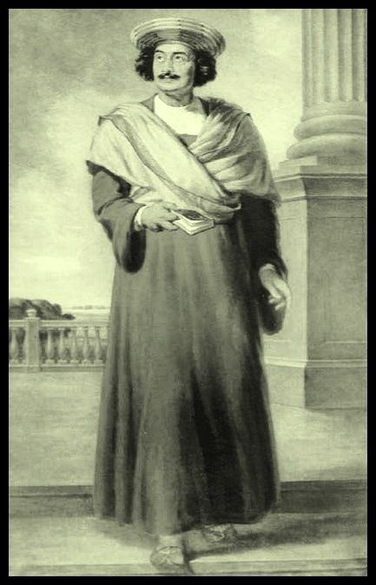
Reformers at Renaissance
Raja Ram Mohon Roy
Enacting laws to criminalize different local customs and practices e.g., Sati dah
Brahma Samaj
Raja Ram Mohan

Slide 19
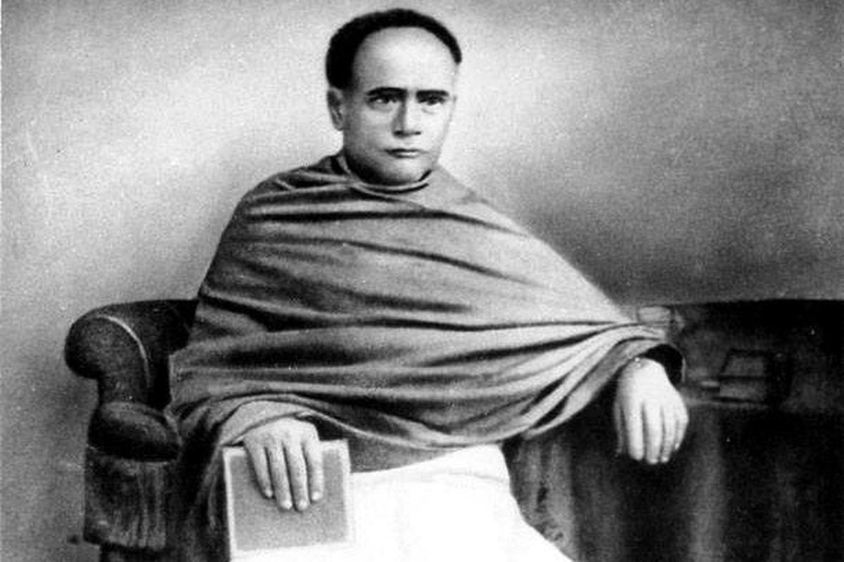
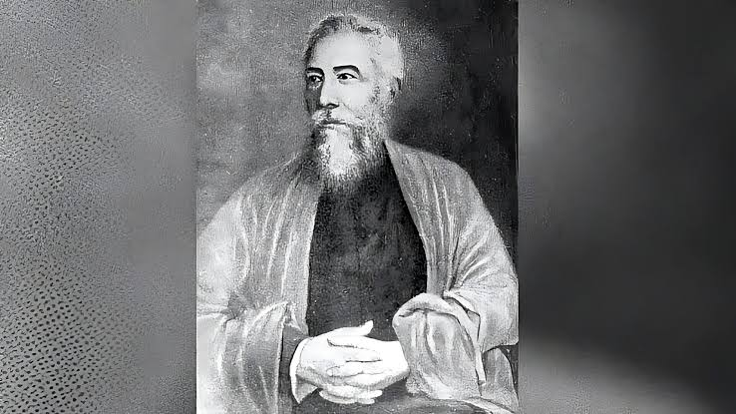

Reformers at Renaissance
Ishwar Chandra Vidyasaagar
Devendranath Tagore
ANNIE. BESANT
Widow remarriage
Bengali Grammar and Alphabetical System
Theosophical society
Established schools and collages
Political Status for women
Theosophical Society,
Indian national Movements

Slide 20
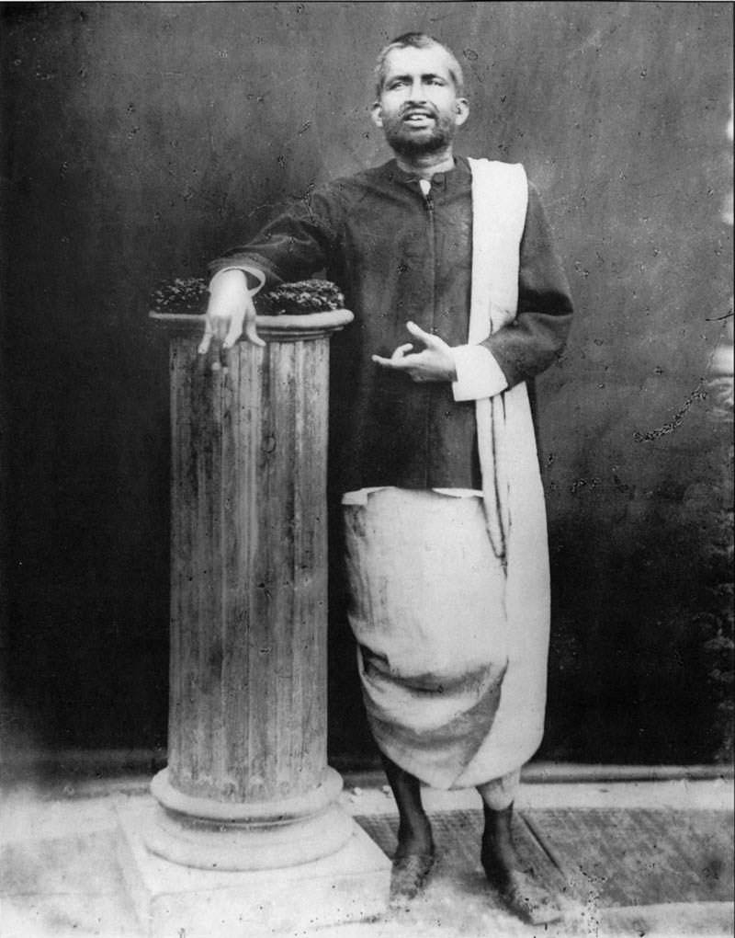
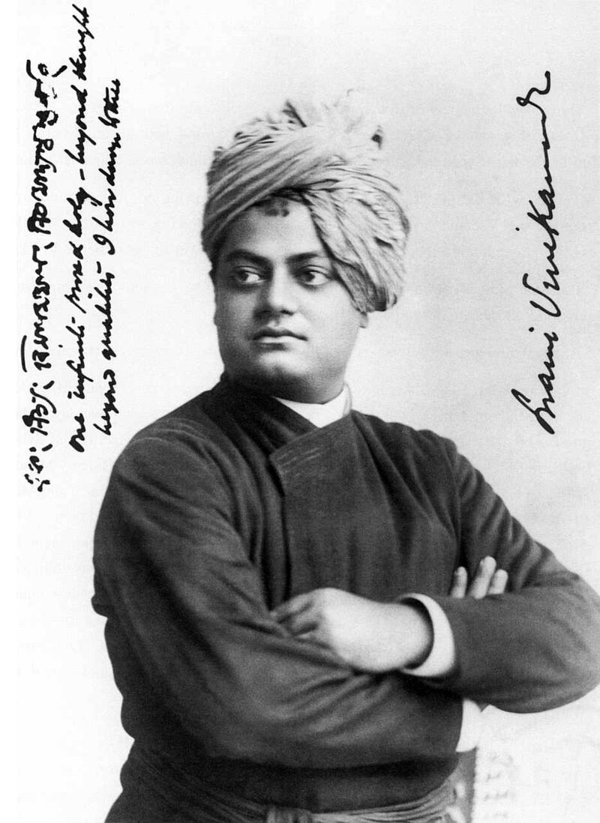
Reformers at Renaissance
Sri Ramakrishna Paramahamsa
Swami Vivekananda
Changed the conflicting ideas of religion
God-realization via various traditions
'যত মত তত পথ'
The Philosophy of Neo-Vedanta
Introduced Indian Spirituality and philosophy in the west
Jiva is Shiva (each individual is divinity itself)/ Social Services

Slide 21
Fakir-Sannyasi Resistance
(1760s-1790s)
Fakir Majnu Shah
Bhabani Pathak
Notes:
Fakir Majnu Shah
Bhabani Pathak

Slide 22
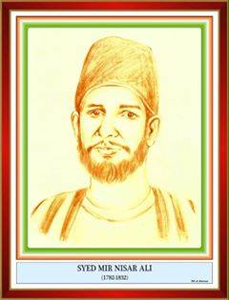
Titu Mir
( 1782-1831)
Notes:
Titu Mir

Slide 23
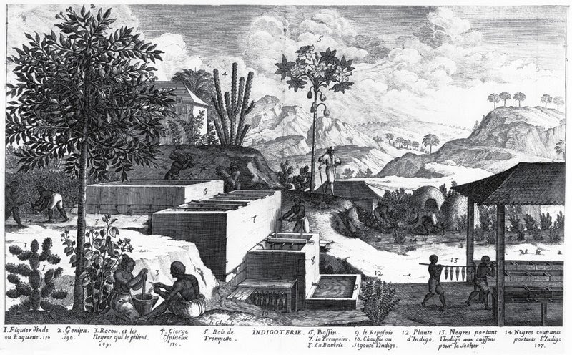
Indigo Resistance Movement
(1859-1862)

Slide 24
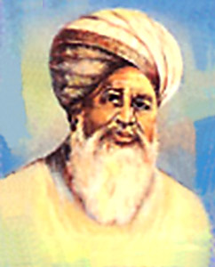
Faraizi Movement
Haji Shariatullah
Dudu Miyan

Slide 25
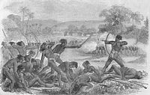
Santhal Rebellion

Slide 26
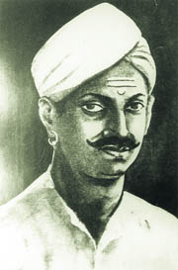
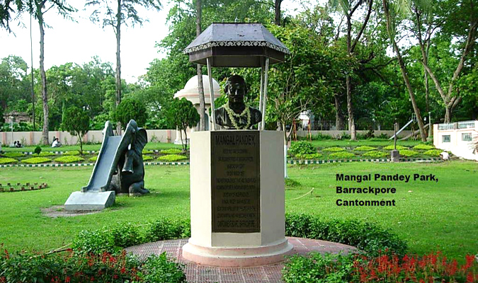

First War of Independence, 1857
Enfield Rifle

Slide 27
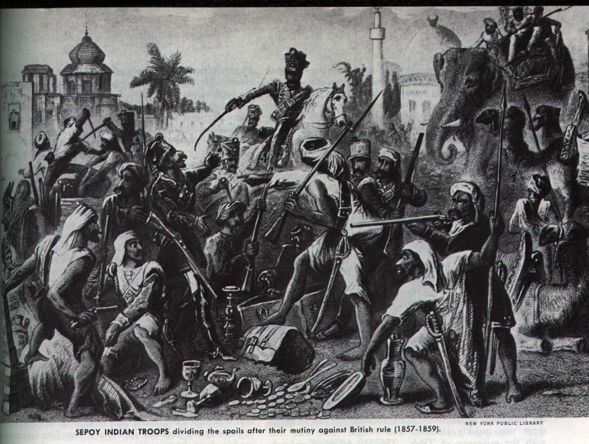
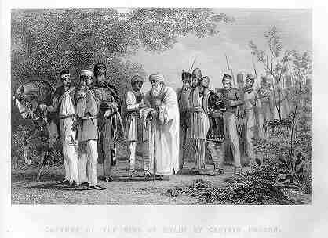
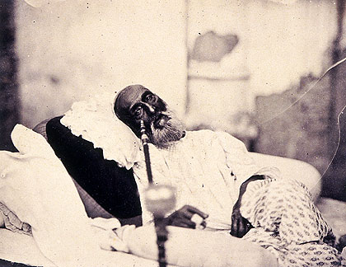
First War of Independence, 1857
Capture of Bahadur Shah Zafar and his sons by William Hodson at Humayun's tomb on 20 September 1857
Bahadur Shah Zafar in 1858, just after his trial in Delhi and before his departure for exile in Rangoon. This is possibly the only photograph ever taken of a Mughal emperor.

Slide 28
Suggested Readings
Bose, Sugata, and Ayesha Jalal, Modern South Asia: History, Culture and Political Economy (New York and London: Routledge, 2004)
Schendel, Willem Van, A History of Bangladesh (New York: Cambridge University Press, 2009)
Sarkar, Sumit, Modern India: 1885-1947 (New Delhi: Pearson, 2014)
Ahmed, A. F. Salahuddin, “Religious and Social Reform Movements in the Nineteenth Century”, in Ahmed, A. F. Salahuddin and Chowdhury, BazlulMobin (Ed.), Bangladesh, National Culture, and Heritage: An Introductory Reader (Dhaka: Independent University Bangladesh, 2004),
Banerjee, Ishita, A History of Modern India ((New York: Cambridge University Press, 2014)
Chopra, P. N.et al., A Comprehensive History of Modern India (New Delhi: Sterling Publishers Private Limited, 2003),
Nitish Sengupta, Land of Two Rivers, (India:Penguin Books, 2011)

Slide 29
Topic for the next class
Class 4
British India 1858- 1911

